Slide 1
“Eagle-Eye”
AgriTech - Perception Blade
Flemming CHRISTENSEN (Flemming.C@sundance.com) – Managing Director
Photo by Fede Roveda from Pexels

Slide 2
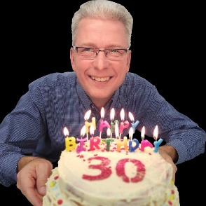
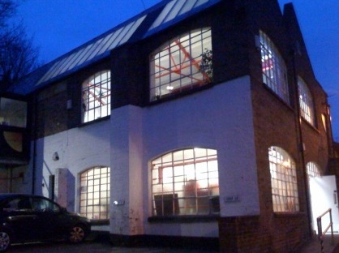
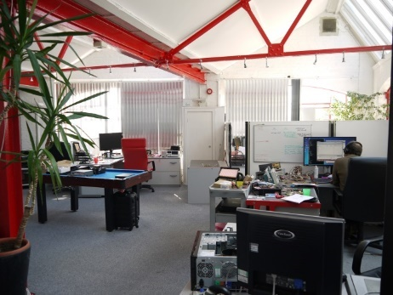
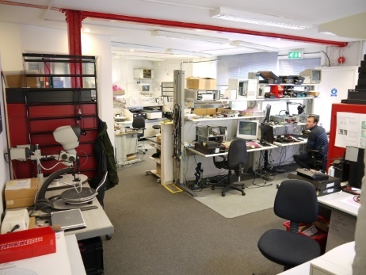
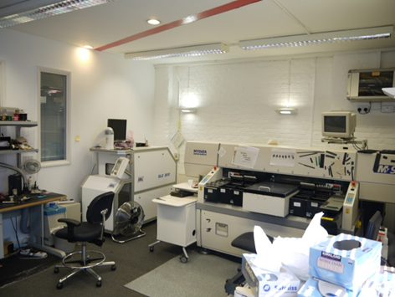
The Business
Established in 1989 by Flemming CHRISTENSEN
Employee Owned and a ’Life-Style’ company
10x people with 300+ years experince
5x with accredited Xilinx FPGA training
Always designed and built our own products
BSI - ISO9001-2015 certified, since 2003
Techology Focus
Edge-AI Acceleration,Vision, Sensor & Robotics = AgriTech
2
Notes:
Flemming

Slide 3
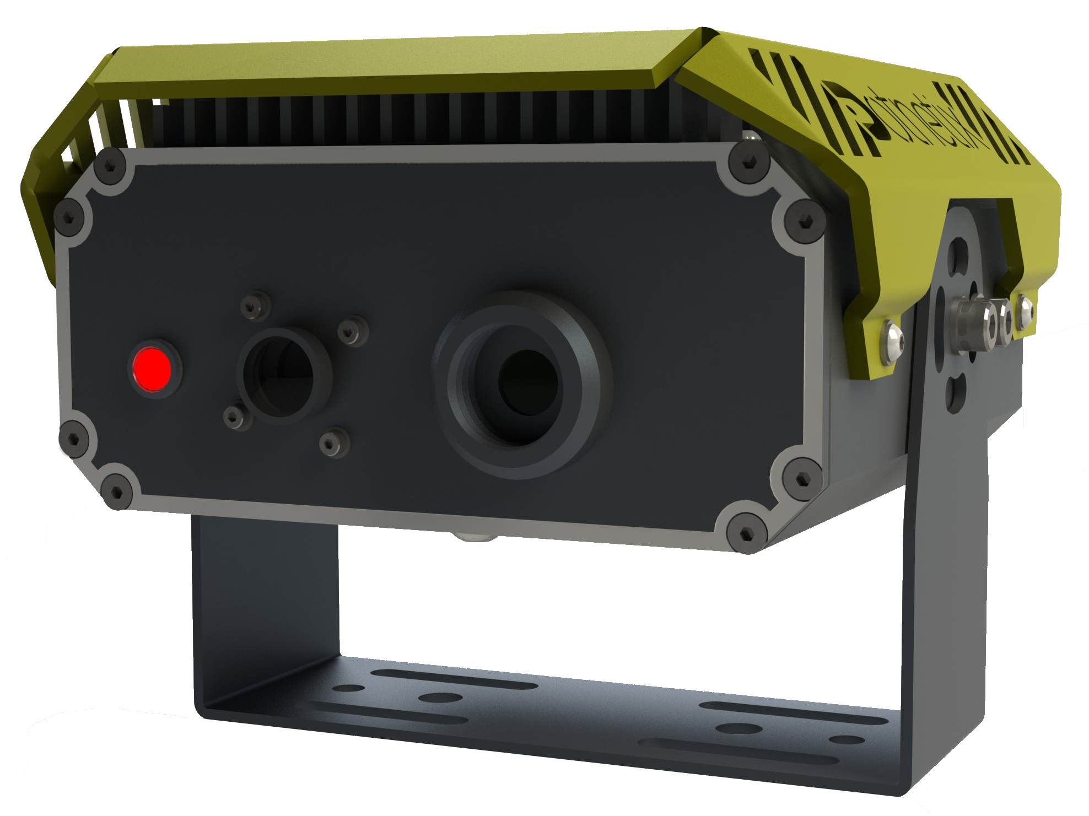
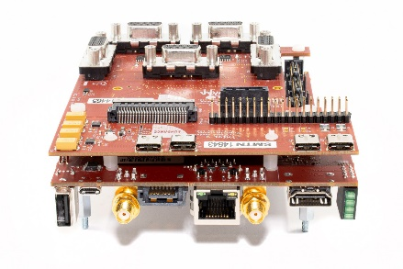
“Eagle-eye” camera
Cloud-less Computing
Also called: Edge-AI
Used in Mining Systems
(Monitoring of people)
Used in AgriTech
(Precision spraying)
Thermal and 3D imaging
Facial recognition
High
accuracy
Multi-person
Detection
http://bit.ly/VCS_1_HomePage
Notes:
Flemming

Slide 4
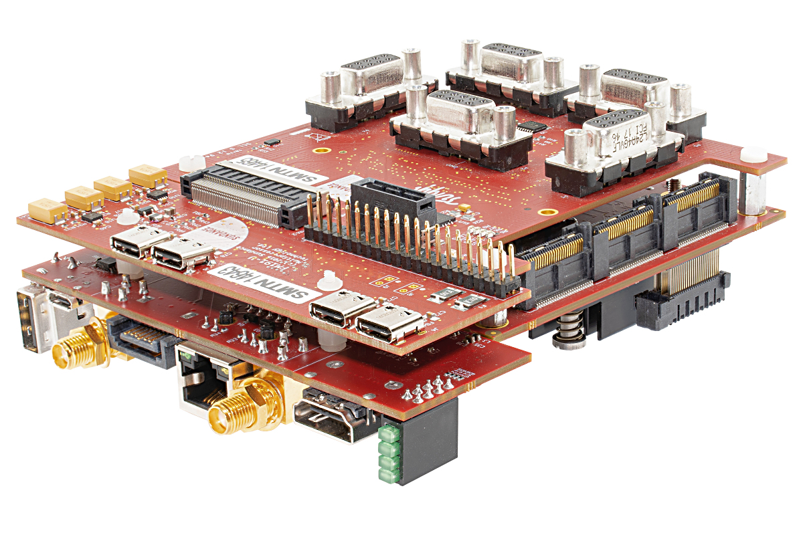
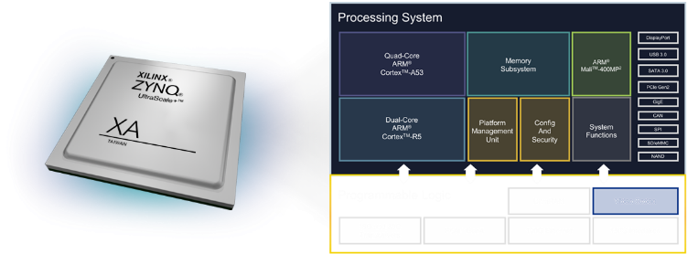
Edge-AI Technology
The Edge-AI technology comes from a number of EU H2020 projects and a book has been released
https://bit.ly/Tulipp_Zynq_Book
VCS-1 is using Xilinx Zynq SoC w. FPGA acceleration
http://bit.ly/Xilinx-Vitis-AI
The “Eagle-Eye” is an enabling technology and not a “Ready-Meal” solution.
Notes:
Flemming

Slide 5
“Eagle-eye” demo applications
http://bit.ly/VCS-1_Precision_Spraying

Slide 6
“Eagle-eye” demo Applications
http://bit.ly/Tullip_Use_Case_UAV

Slide 7
“Eagle-eye” demo Applications
http://bit.ly/VCS1_VineScout

Slide 8
“Eagle-eye” demo Applications
https://bit.ly/VCS_Apple_Counting

Slide 9
“Eagle-eye” demo Applications
http://bit.ly/VCS1_NDVI

Slide 10
“Eagle-eye” demo Applications
http://bit.ly/VCS1_NDVI

Slide 11
“Eagle-eye” demo Applications
http://bit.ly/VCS1_Strawberry_Detection

