Slide 1
49th Intelligent Sensing Program
Sensing in Precision (Digital) Agriculture
Notes:
https://cordis.europa.eu/project/rcn/206207/factsheet/en
http://vinescout.eu/web/
This project has received funding from the European Union´s Horizon 2020 Programme under grant agreement no 737669
http://vinescout.eu/web/the-challenge-lab-to-field

Slide 2
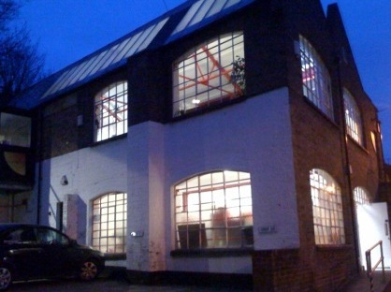
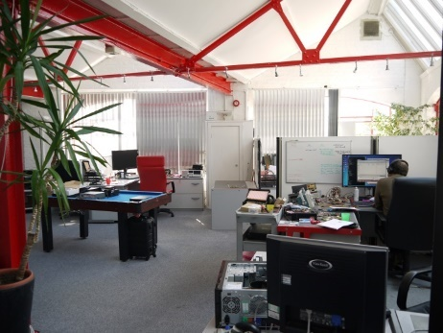
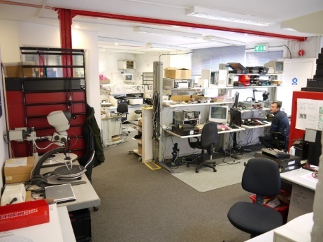
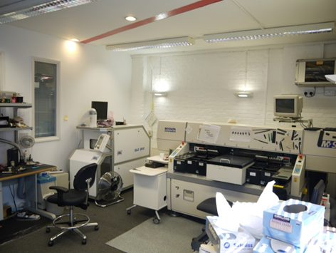
The company
Established in 1989 by Flemming CHRISTENSEN
Employee Owned and a ’Life-Style’ company
12x people with 300+ years experince
4x with accredited Xilinx FPGA training
Always designed and built our own products
BSI - ISO9001-2015 certified, since 2003
Techology Focus
Acceleration & Vision,
Sensor & Robotics
2

Slide 3
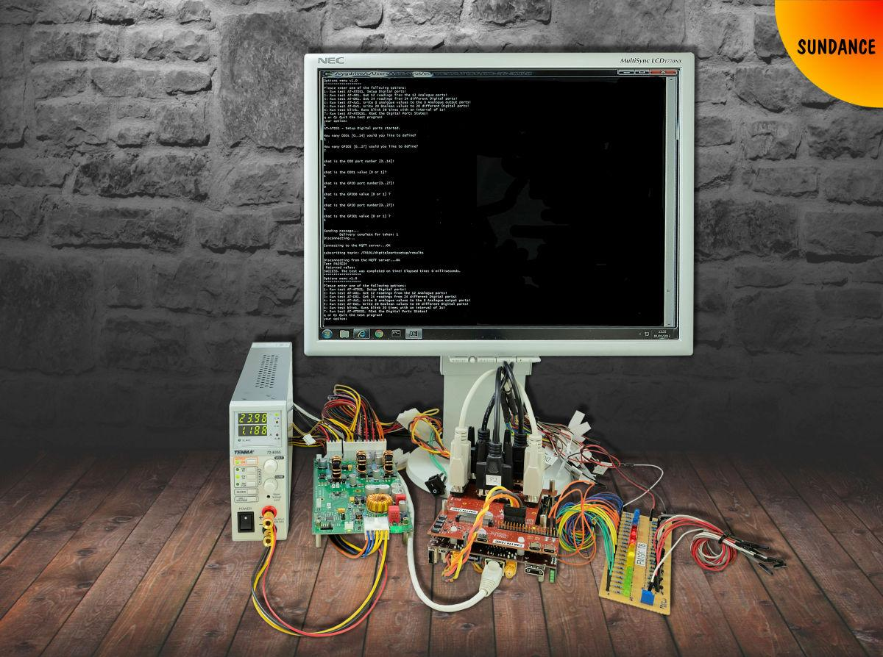
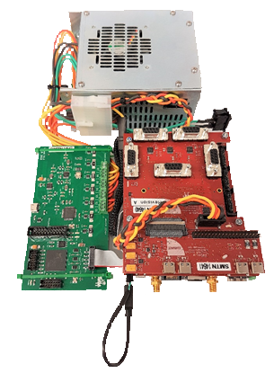
Overview of the VCS-1 SYSTEM
Overview
Hardware features
Sensors compatibility
Industry compatibility
Open software and firmware
PYNQ (Python) support
EDGE AI support
Applications
Endorsement
Summary
What Next?
Notes:
* VCS was started in www.tulipp.eu, as flexible development platform for Low-Power Image Processing. It was expanded to cover multiple sensors during the www.vinescout.eu project.
VCS is a lightweight (300grams) electronics platform for “Vison, Control and Sensors” with a focus on controlling robots capable of operating in resilient environments such the ones that can be found in vineyards, orchards and greenhouses.
The primary design focus is edge AI, using low-power accelerators to provide processing-power when required and total power consumption is below 10 watts for the processing unit.
The VCS is built on a PC/104 PCB (90mm x 96 mm) – an industry standard form-factor with additional “Sundance External Interface Card” [SEIC] to provide I/O.
The SEIC is a low-cost PCB that can be removed from the processing board with a cable; also, possible to design a simple 4-layer PCB with ‘custom’

Slide 4
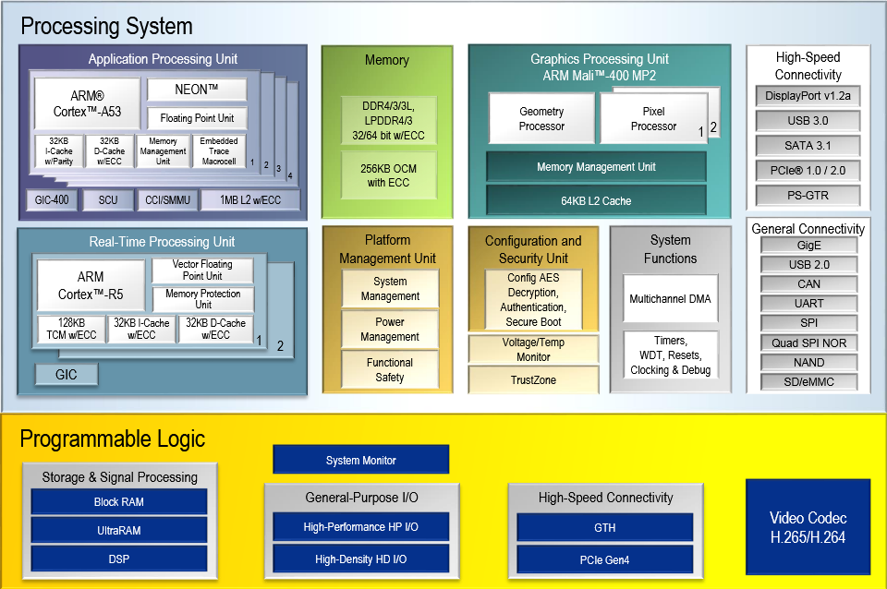
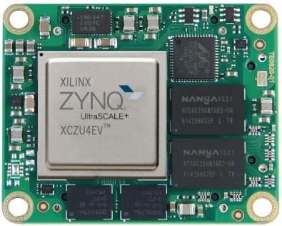
HARDWARE FEATURES
Multiprocessor system
A Xilinx Zynq MPSoC is the ‘heart’ of VCS-1 and provide 64-bit processor scalability while combining real-time control with soft and hard engines for graphics, video, waveform, and FPGA acceleration, using a Trenz TE0820 “SoM”.
TEO820-ZU4EV
ZU4EV
Notes:
Sundance is a “Certified Xilinx Alliance Partner” – and has been using Xilinx FPGA since 1993 to do acceleration
The choice of a Xilinx SoC/FGPA (Zynq) as the ‘heart’ of the VCS will give provide the processing power and low latency I/O
The Zynq is fitted onto VCS, using a 40mm x 50mm “SoM” (System-on-Module) to enable upgrade (or downgraded, to reduce performance/cost) of the VCS over time. The I/O interfaces/features of VCS are industry standard and not likely to require updates, as not on the critical path for AI processing
Application Unit (Quad-core 64-bit ARM Cortex A53 CPU)
Required for running a Linux based OS/ ROS compatible
GPU (ARM Mali 400)
Required for accelerating graphics.
RTU (ARM Cortex R5)
Required for managing real-time events.
Programmable (FPGA) Logic
Required for performing hardware acceleration of AI algorithms used to for on-the-fly image processing/classification.
I/O - a large selection of input/output standards are implemented directly on the Programmable Logic to reduce the latency between the various cameras, sensors and servo-motors, controlled by ROS or Python programming suits.

Slide 5
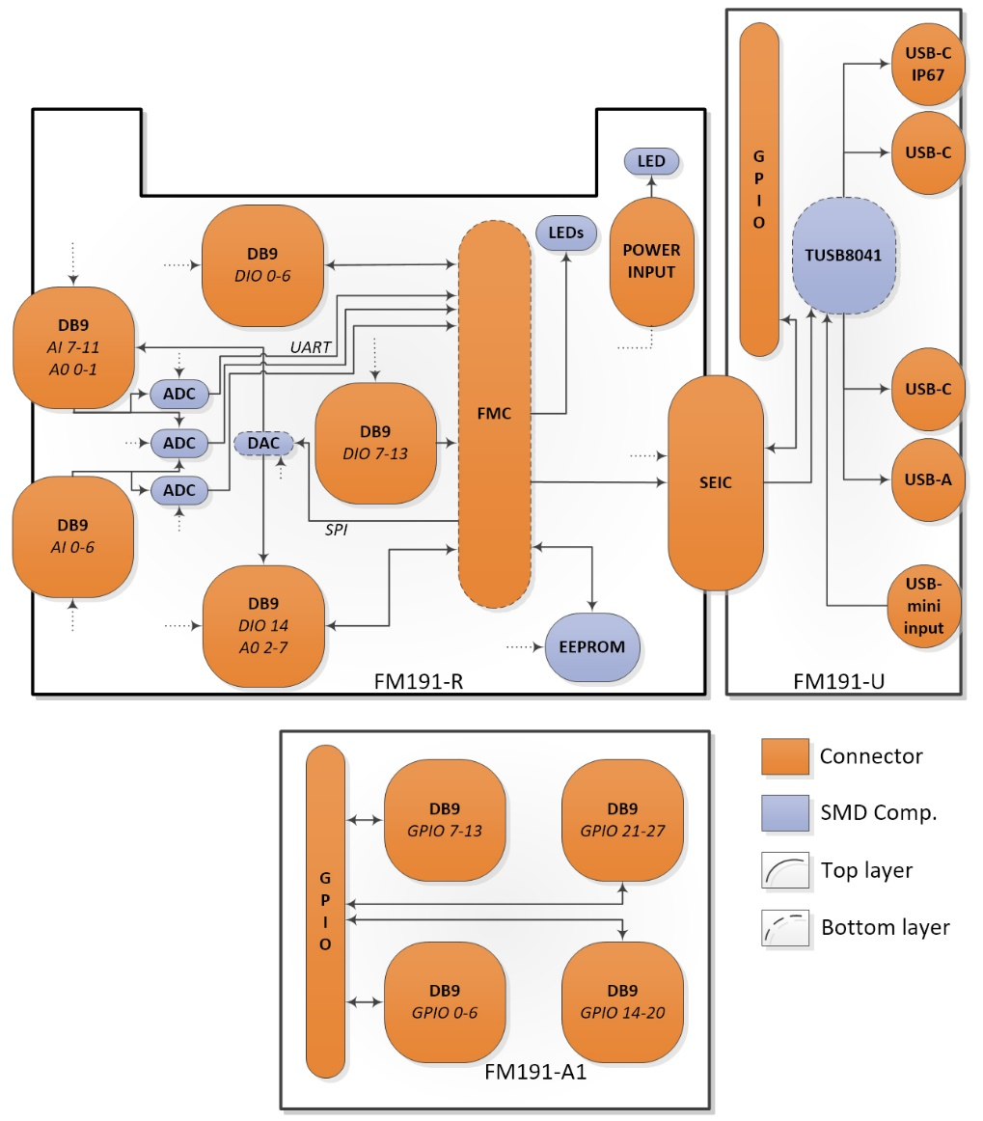
Hardware FEATURES
I/O interfaces
Connectivity:
FM191-R; FMC-LPC to:
15x Digital I/Os [DB9]
12x Analogue Inputs [DB9]
8x Analogue Outputs [DB9]
1x Expansion [SEIC]
FM191-U; SEIC to:
4x USB3.0 [USB-c]
28x GPIO [40-pin GPIO]
FM191-A1; 40-pin GPIO
28x GPIO [DB9]
FM191
Notes:
The versatility of VCS is the modular concept of the SoM processing element on a PC/104 baord, combined with a separate I/O Module
Has plenty of ADC, DAC, I/O and expansion with PC/104

Slide 6
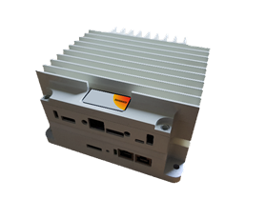
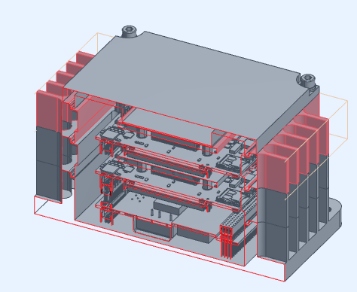
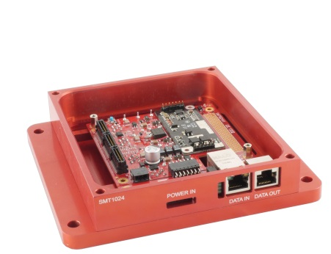
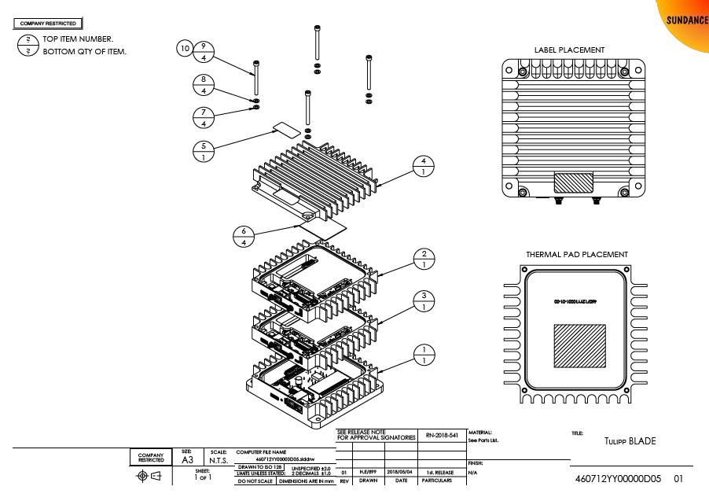
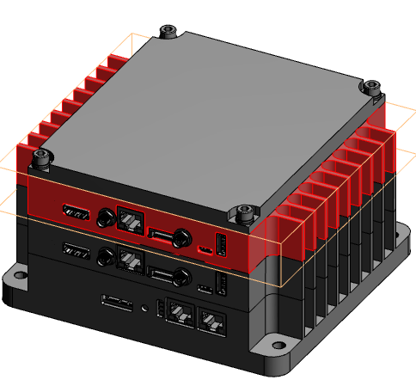
Hardware FEATURES
Rugged Enclosure
A custom enclosure was specially designed for accommodating the VCS-1 system, called PC104-Blade
Notes:
The PC104-Blade is a stackable concept for PC/104 boards. It will remove the need for any fans and provide a rugged environment for building solutions for embedded applications

Slide 7
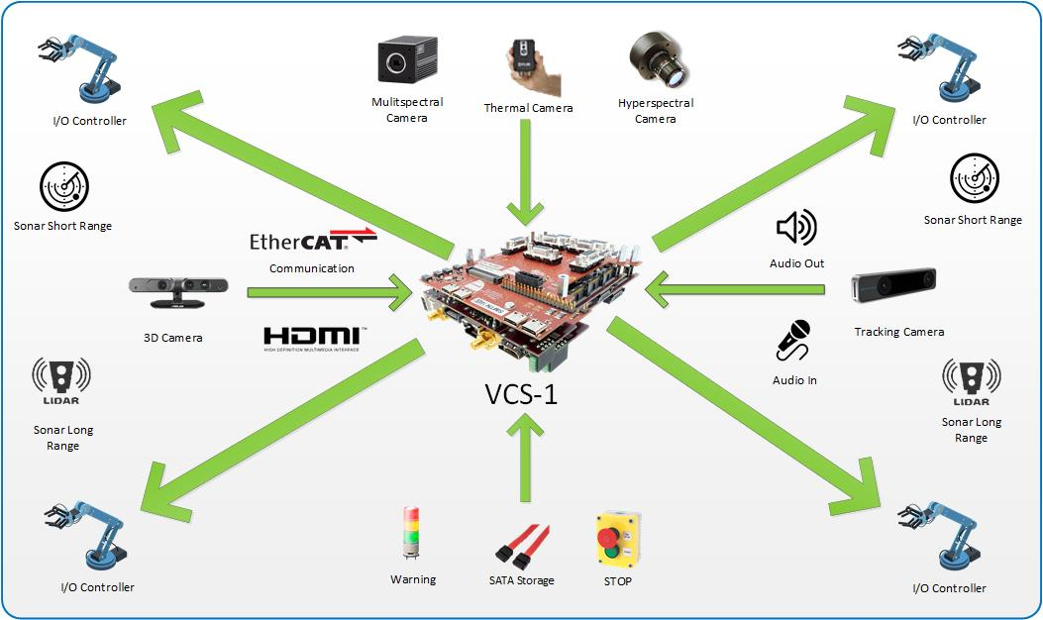
sensors compatibility
The VCS-1 is compatible with a wide range of sensors, like:
Depth sensor. Interface USB3.0
Intel RealSense - D435
Tracking sensor. Interface USB3.0
Intel RealSense – T265
Notes:
VCS has multiple USB3 interfaces for interface to different cameras and sensors
Intel RealSense D435 - Depth camera
Intel RealSense T265 – Tracking camera
Stereo Labs Zed Camera - Depth camera
FLIR AX-8 - Thermal camera
Also, has all ‘typical’ interface to allow VCS to be a like a PC with HMDI display, SATA and Ethernet.
The ADC can get data from external sensors, etc.
The DAC can control servo-motors, etc.

Slide 8
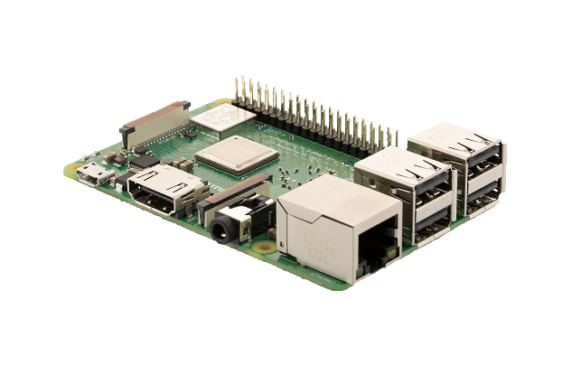
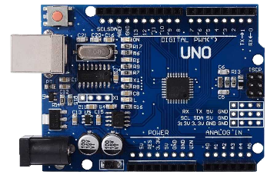
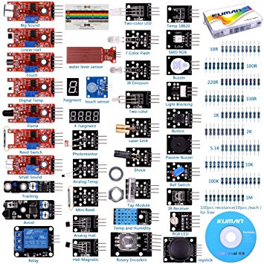
industry compatibility
VCS-1 features:
Raspberry Pi version 3 model B and Arduino compatible
Compatible with most of the Arduino/Raspberry Pi sensors and actuators
USB3.0 & Ethernet ports for interfacing with a wide range of sensors
Notes:
Can connector with Raspberry PI and Arduino shields and actuactors

Slide 9
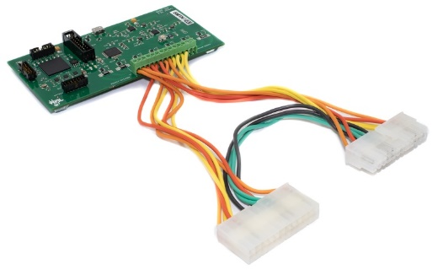
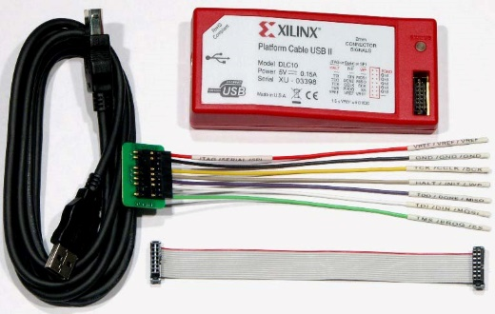
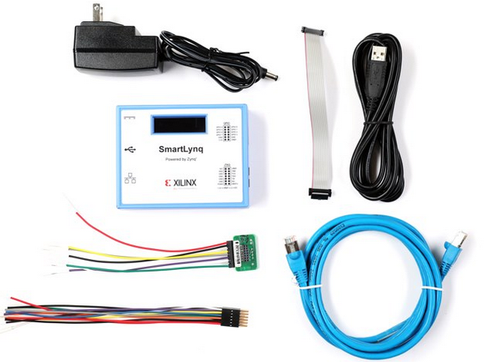
hardware debug tools
VCS hardware debugging is easy with industry standard JTAG directedly into the Zynq MPSoC
TULIPP’s LynSyn Power Monitor & Toolchain
http://bit.ly/VCS_Lynsyn
http://bit.ly/VCS_Tulipp_Toolchain
Xilinx JTAG Platform Hardware Cable
http://bit.ly/VCS_JTAG_Cable
Xilinx JTAG SmartLynq Cable
http://bit.ly/VCS_SmartLynq_Cable
Notes:
Can connector with Raspberry PI and Arduino shields and actuactors
Software support:
ROS Melodic - Robotic platform
MQTT – Machine-to-Machine” connectivity
OpenCV 4.0.1 - Computer Vision Library
Intel Movidius - Neuromorphic chip
Python 2.7 and 3.6 support - Scripting Programming Language
Ubuntu 18.04 LTS - Operating System
Xilinx SDSoC environment (HLS – ‘C’ to ‘VHDL’)
TULIPP’s STHEM Toolchain (on GitHub) with Lynsyn Power Monitor Unit (PMU)
Xilinx DPU for Convolutional Neural Network

Slide 10
open source
Open Source and online documentation:
CERN’s Open Hardware Repository
http://bit.ly/VCS_OHR
VCS Hardware
http://bit.ly/VCS_Hardware
VCS Software
http://bit.ly/VCS_Software
VCS Firmware
http://bit.ly/VCS_FM191_firmware
Notes:
Documentation (user and reference manuals, schematics, software specs and wiki)
Hardware firmware and instructions on how to build it from scratch
Software (C/C++ Windows/Linux SDKs and demos using Artificial Intelligence Algorithms in C/C++ and python)
All the VCS firmware and software is available in the following GitHub repository:
https://github.com/SundanceMultiprocessorTechnology/VCS-1

Slide 11
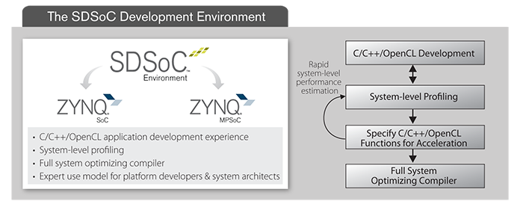
VCS-1 Development tools
VCS’s “Processing System” (PS) running within the ARM A53 CPUs, is supported by Linux:
http://bit.ly/VCS_Xilinx_Linux
https://ubuntu.com/
VCS has a version of Ubuntu 16.04 LTS and 18.04 LTS ported and for free download.
Xilinx also offers free option of an embedded Linux for Zynq, called PetaLinux:
http://bit.ly/VCS_Peta_Linux
The VCS’s “Programable Logic” (PL) – that is the ‘classic’ FPGA fabric - is supported by the free WebPACK & SD-SoC environment from Xilinx:
http://bit.ly/VCS_Vivado_Zynq
http://bit.ly/VCS_C_to_VHDL_SDSoC
Notes:
Software support:
ROS Melodic - Robotic platform
MQTT – Machine-to-Machine” connectivity
OpenCV 4.0.1 - Computer Vision Library
Python 2.7 and 3.6 support - Scripting Programming Language
Ubuntu 18.04 LTS - Operating System
Xilinx SDSoC environment (HLS – ‘C’ to ‘VHDL’)
TULIPP’s STHEM Toolchain (on GitHub) with Lynsyn Power Monitor Unit (PMU)
Xilinx DPU for Convolutional Neural Network

Slide 12
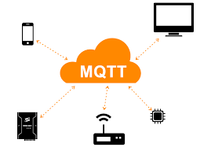
programming tools
MQTT compatible
OASIS standard
Machine-to-machine (M2M)/"Internet of Things" connectivity protocol.
OpenCV compatible
Open source computer vision and machine learning software library.
ROS compatible
The Robot Operating System (ROS) is a set of software libraries and tools that helps building robot applications.
ROS2 ready
PYNQ compatible
PYNQ is an open-source project from Xilinx that is utilizing Python & Jupyter to make it easy to design embedded systems with Zynq

Slide 13
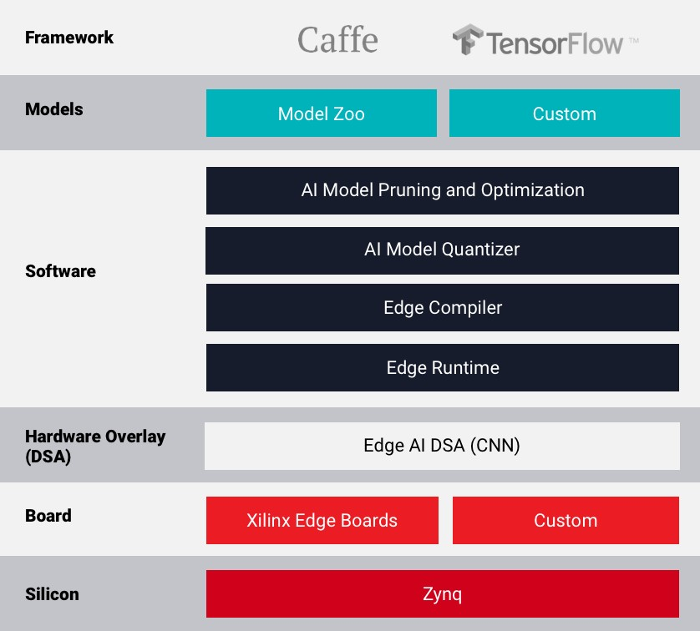
Edge-AI
The VCS-1 is fully compatible with the Xilinx Edge-AI.
The Xilinx Edge-AI Platform provides comprehensive tools and models which utilize unique deep compression and hardware-accelerated Deep Learning technology.
The platform provides efficient, convenient and economical inference deployments for embedded-CPU-based FPGAs.
The Xilinx AI team consists of renowned researchers and experienced professionals known for their pioneering work in the field of deep learning.
Xilinx Edge - AI

Slide 14
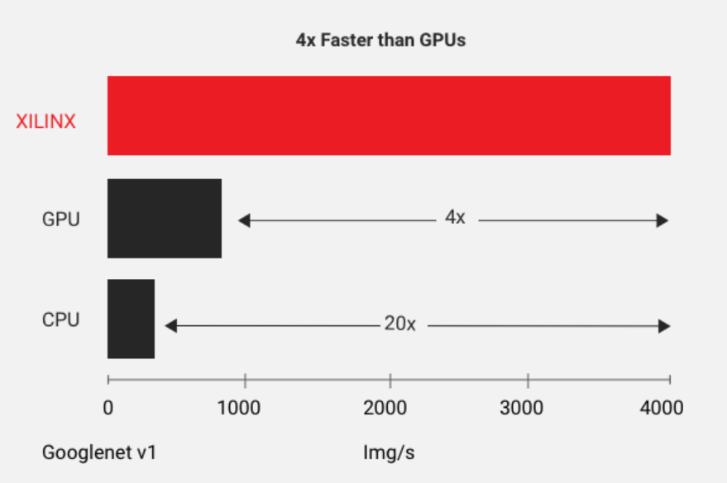
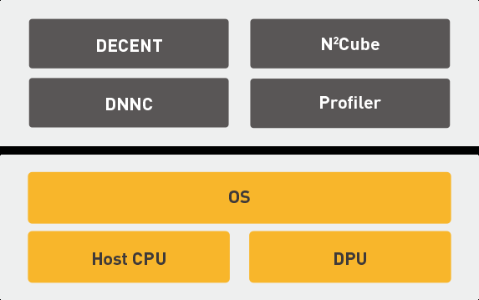
Edge-AI
DNNDK™
(Deep Neural Network Development Kit)
Xilinx-DPU
Key Features
Provides a complete set of toolchains with compression, compilation, deployment and profiling.
Supports mainstream frameworks and the latest models capable of diverse deep learning tasks
Provides a lightweight standard C/C++ programming API (no RTL programming knowledge required)
Scalable board support from cost-optimized to performance-driven platforms
Supports system integration with both SDSoC and Vivado
DNNDK consists of:
DEep ComprEssioN Tool (DECENT)
Deep Neural Network Compiler (DNNC)
Neural Network Runtime (N2Cube)
Profiler

Slide 15
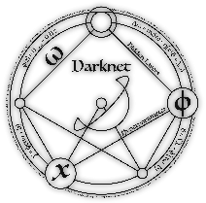
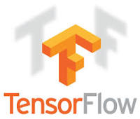
Edge-AI
Frameworks
Xilinx Edge-AI
Xilinx Edge-AI Platform supports a number of industry-standard frameworks
TensorFlow is an open-source framework developed by Google.
CAFFE is an open-source framework developed at UC Berkley.
Darknet is an open-source framework developed by Joseph Redmon.
Keras is a high-level neural networks API, written in Python and capable of running on top of TensorFlow.

Slide 16
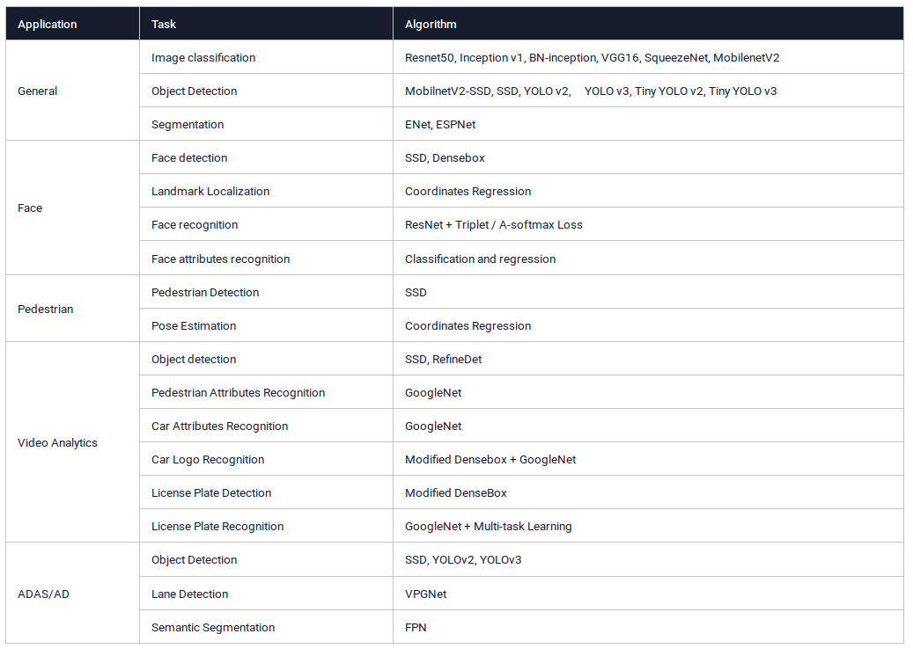
Edge-AI
Models

Slide 17
Applications
http://bit.ly/VCS1_SLAM
http://bit.ly/VCS_Edge-AI

Slide 18
VCS-1 Applications
http://bit.ly/VCS1_NDVI
http://bit.ly/VCS1_NN

Slide 19
VCS-1 Applications
http://bit.ly/VCS1_VineScout

Slide 20
VCS-1 Applications
http://bit.ly/VineScout_VCS_Summit_XL
http://bit.ly/Tullip_Use_Case_UAV

Slide 21
VCS-1 Endorsement
Notes:
http://tulipp.eu/advisory-board-endorsements/

Slide 22
VCS-1 Endorsement
http://semfire.ingeniarius.pt/
Notes:
http://tulipp.eu/advisory-board-endorsements/

Slide 23
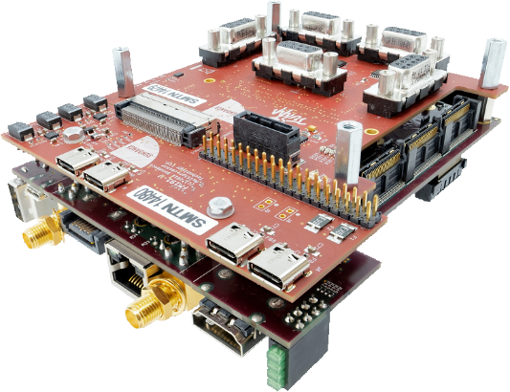
Summary
The VCS-1 has the following characteristics:
High performance, using ‘state-of-the-art’ Xilinx Zynq MPSoC
Low power consumption (typical 10W)
Highly compatible with a wide range of commercially available sensors and actuators
Highly optimised for computer vision applications, embedded AI and Deep Learning
Fully reconfigurable and expandable using PC/104 form-factor (90mm x 96mm)
Compatible with the most common Linux distros (I.e. Ubuntu, Debian, RedHat, CentOS, etc.)
Software support for ROS and MQTT
Python and C/C++ support

Slide 24
WHAT’s next ?
Research topics:
Object detection, changes detection, visual-servoing
Autonomous navigation, object grasping
2D>3D Pose estimation, perception, AI in robotics
Sundance University Program (SUP)
Access to hardware prototypes
Advisory Board Members
BSC/MSc/PhD Internships
R&D Project proposals
H2020, Innovate-UK, EuroSTARS
EPSRC/BBSRC/UKRI/SPRINT
https://www.smartagrihubs.eu/portal/network
Want to know more about Sundance in R&D Projects ?
https://www.sundance.com/sundance-in-eu-projects-programs/

Slide 25
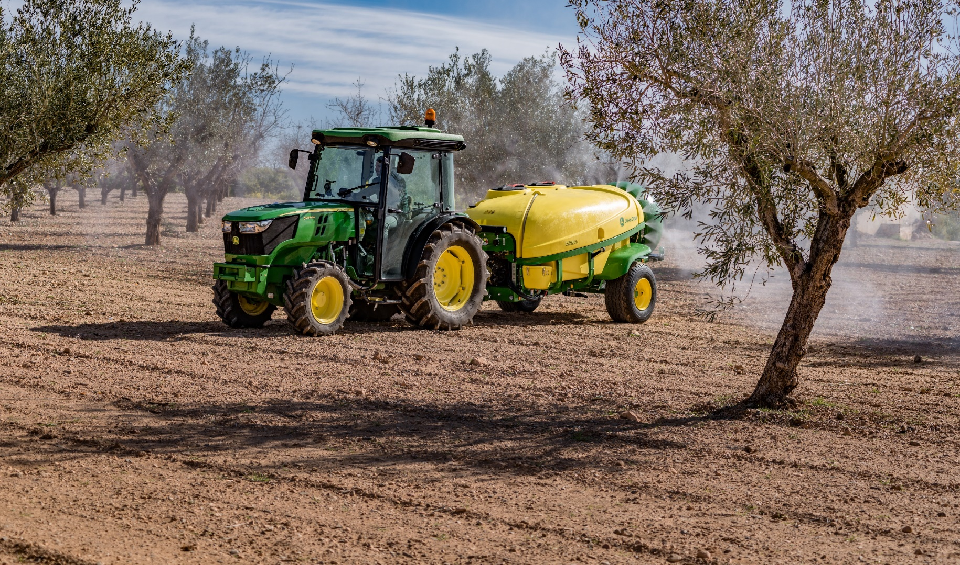
WHAT’s next ?

Slide 26
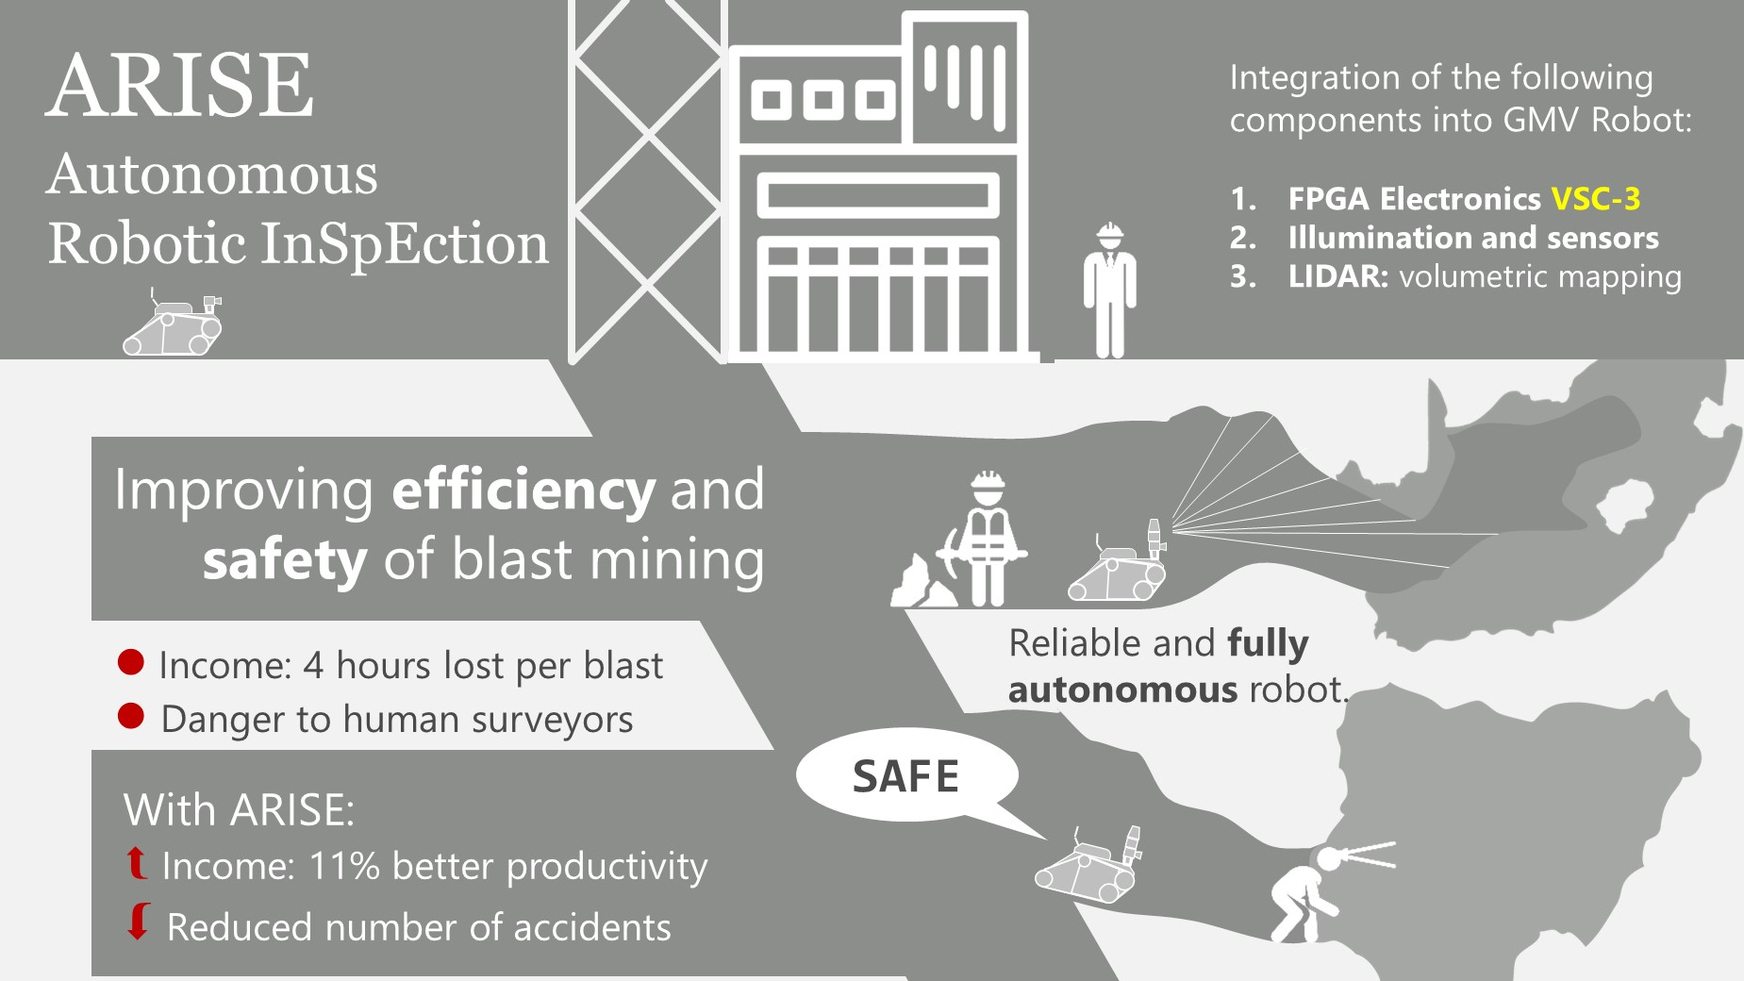
WHAT’s next ?

Slide 27
Sundance Multiprocessor Technology, Ltd.
Pedro Machado Pedro.M@sundance.com
Flemming Christensen Flemming.C@sundance.com

